Slide 1
Spike Sorting with blechpy
8/18/2021

Slide 2
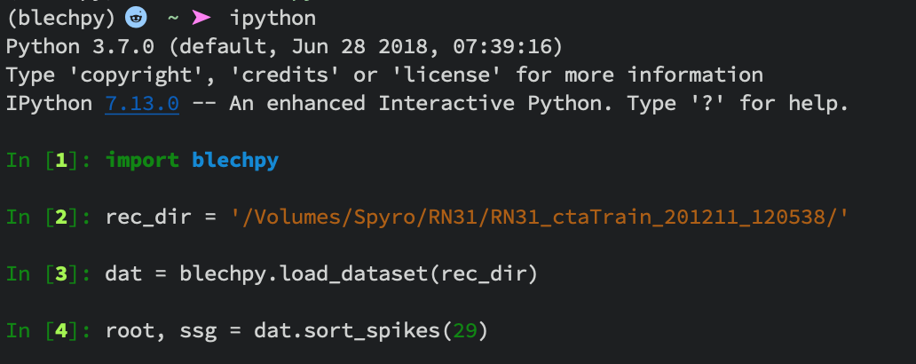
Getting Started
After running clustering: dat.blech_clust_run()
You will not have a BlechClust Folder inside your recording directory,
and spike sorting can now be run.
Important: Look through the images in the BlechClust Folder and make sure clustering ran properly before beginning spike sorting. If you need to re-run clustering with different parameter, do so before beginning sorting. Starting spike sorting will delete raw and referenced electrode traces from the .h5 file and prepare the .h5 file to store sorted unit spike times and waveforms.

Slide 3
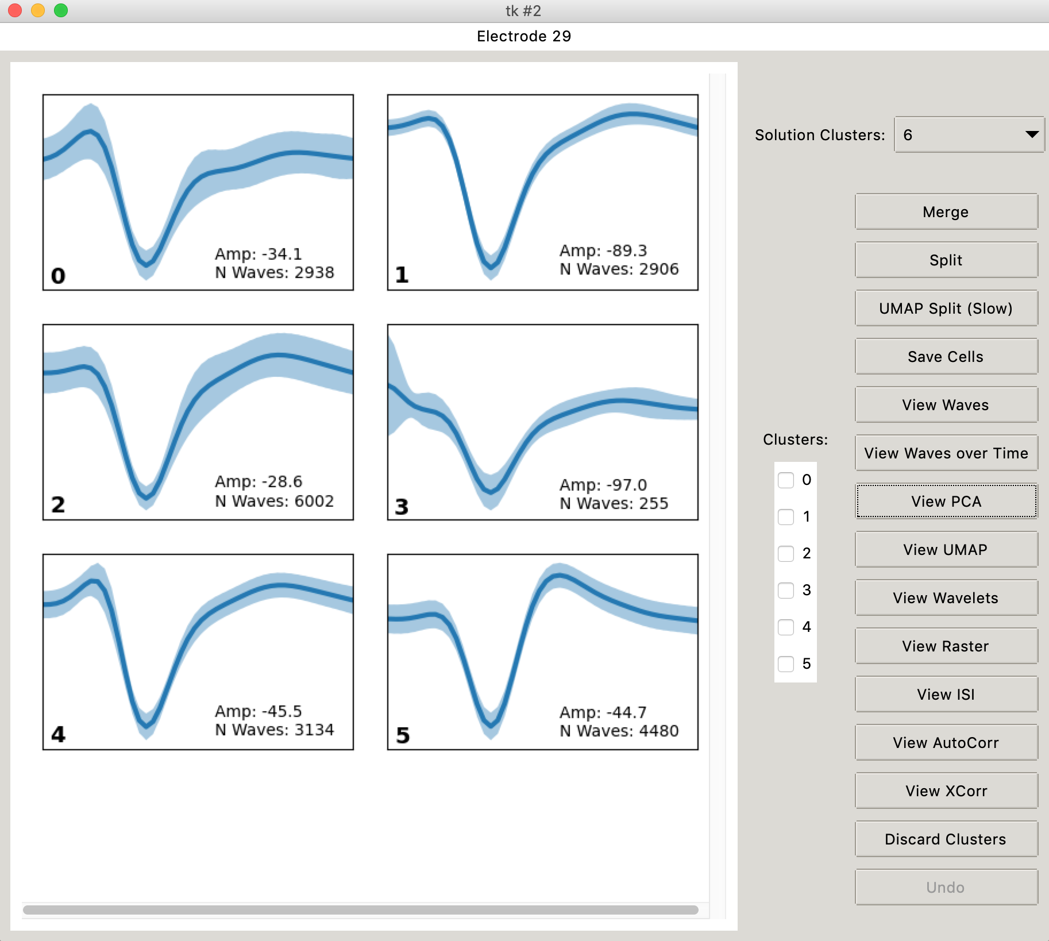
Blechpy Spike Sorter

Slide 4
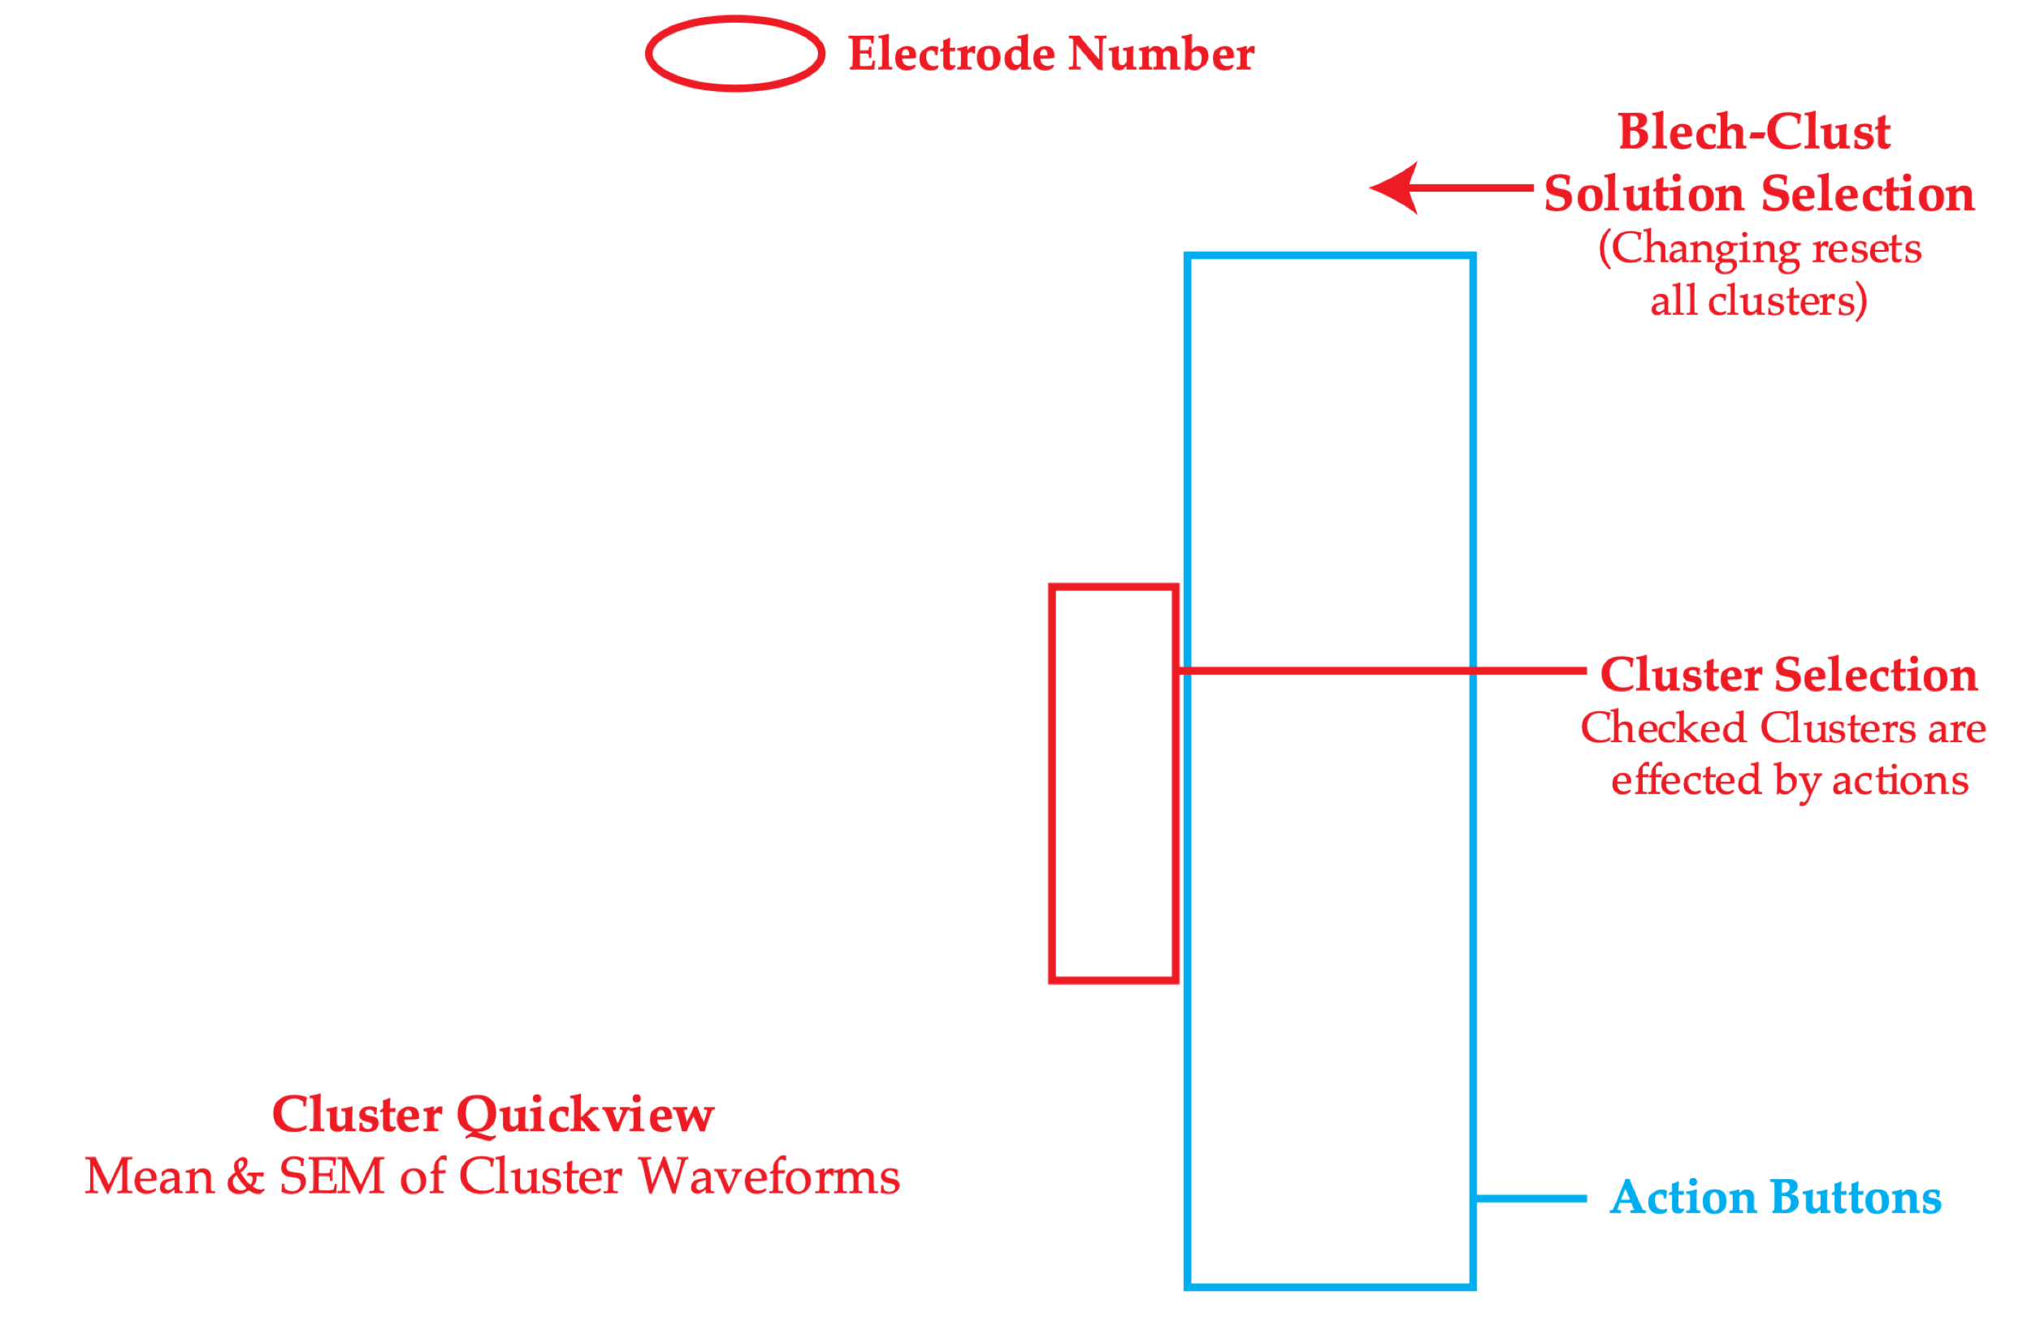
Blechpy Spike Sorter

Slide 5
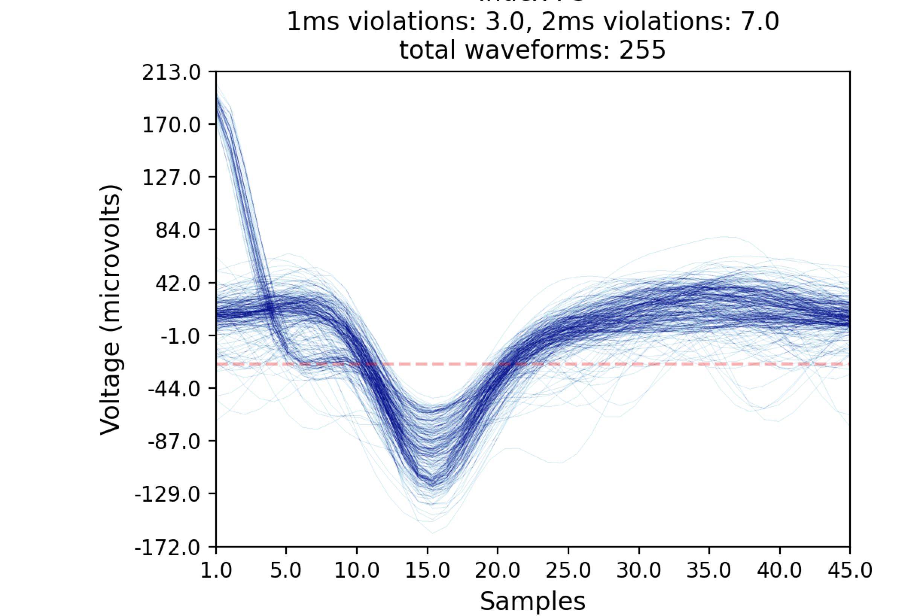
View Waves
Index: 3

Slide 6
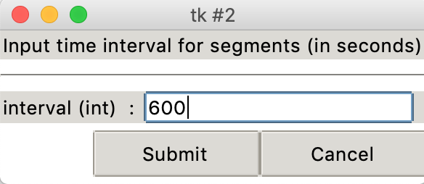
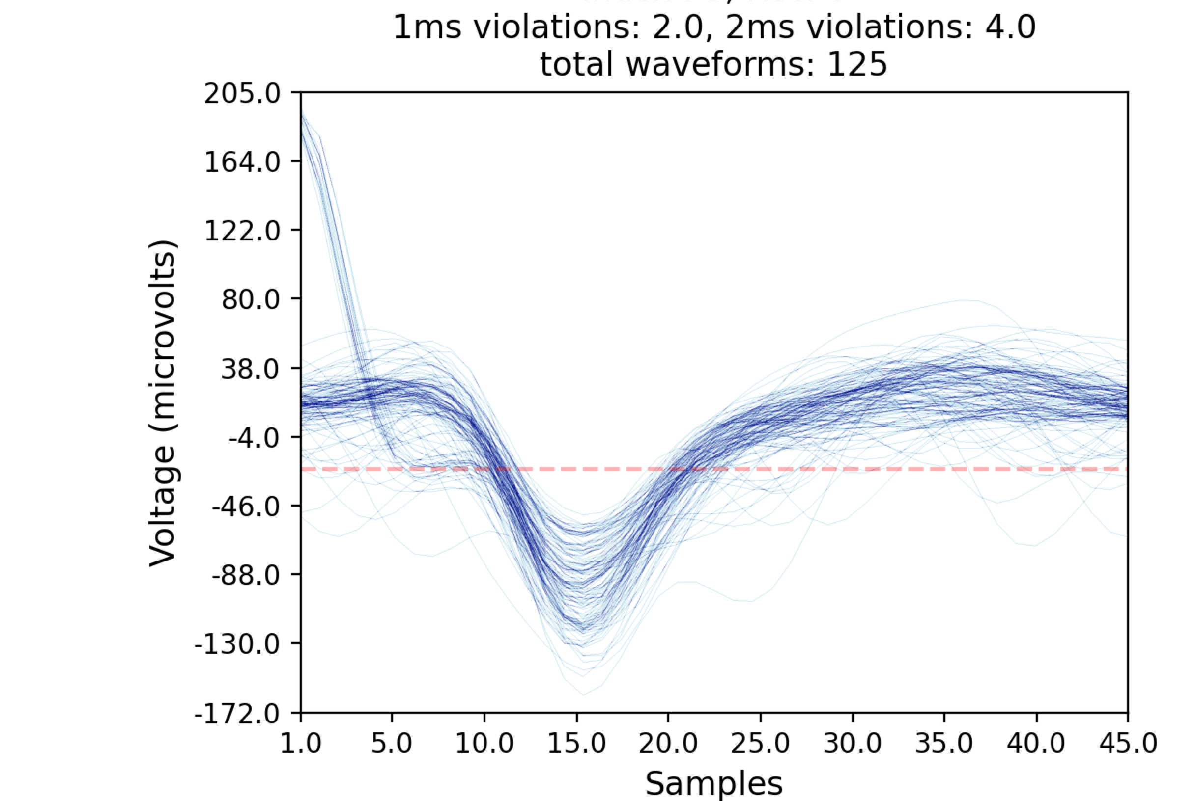
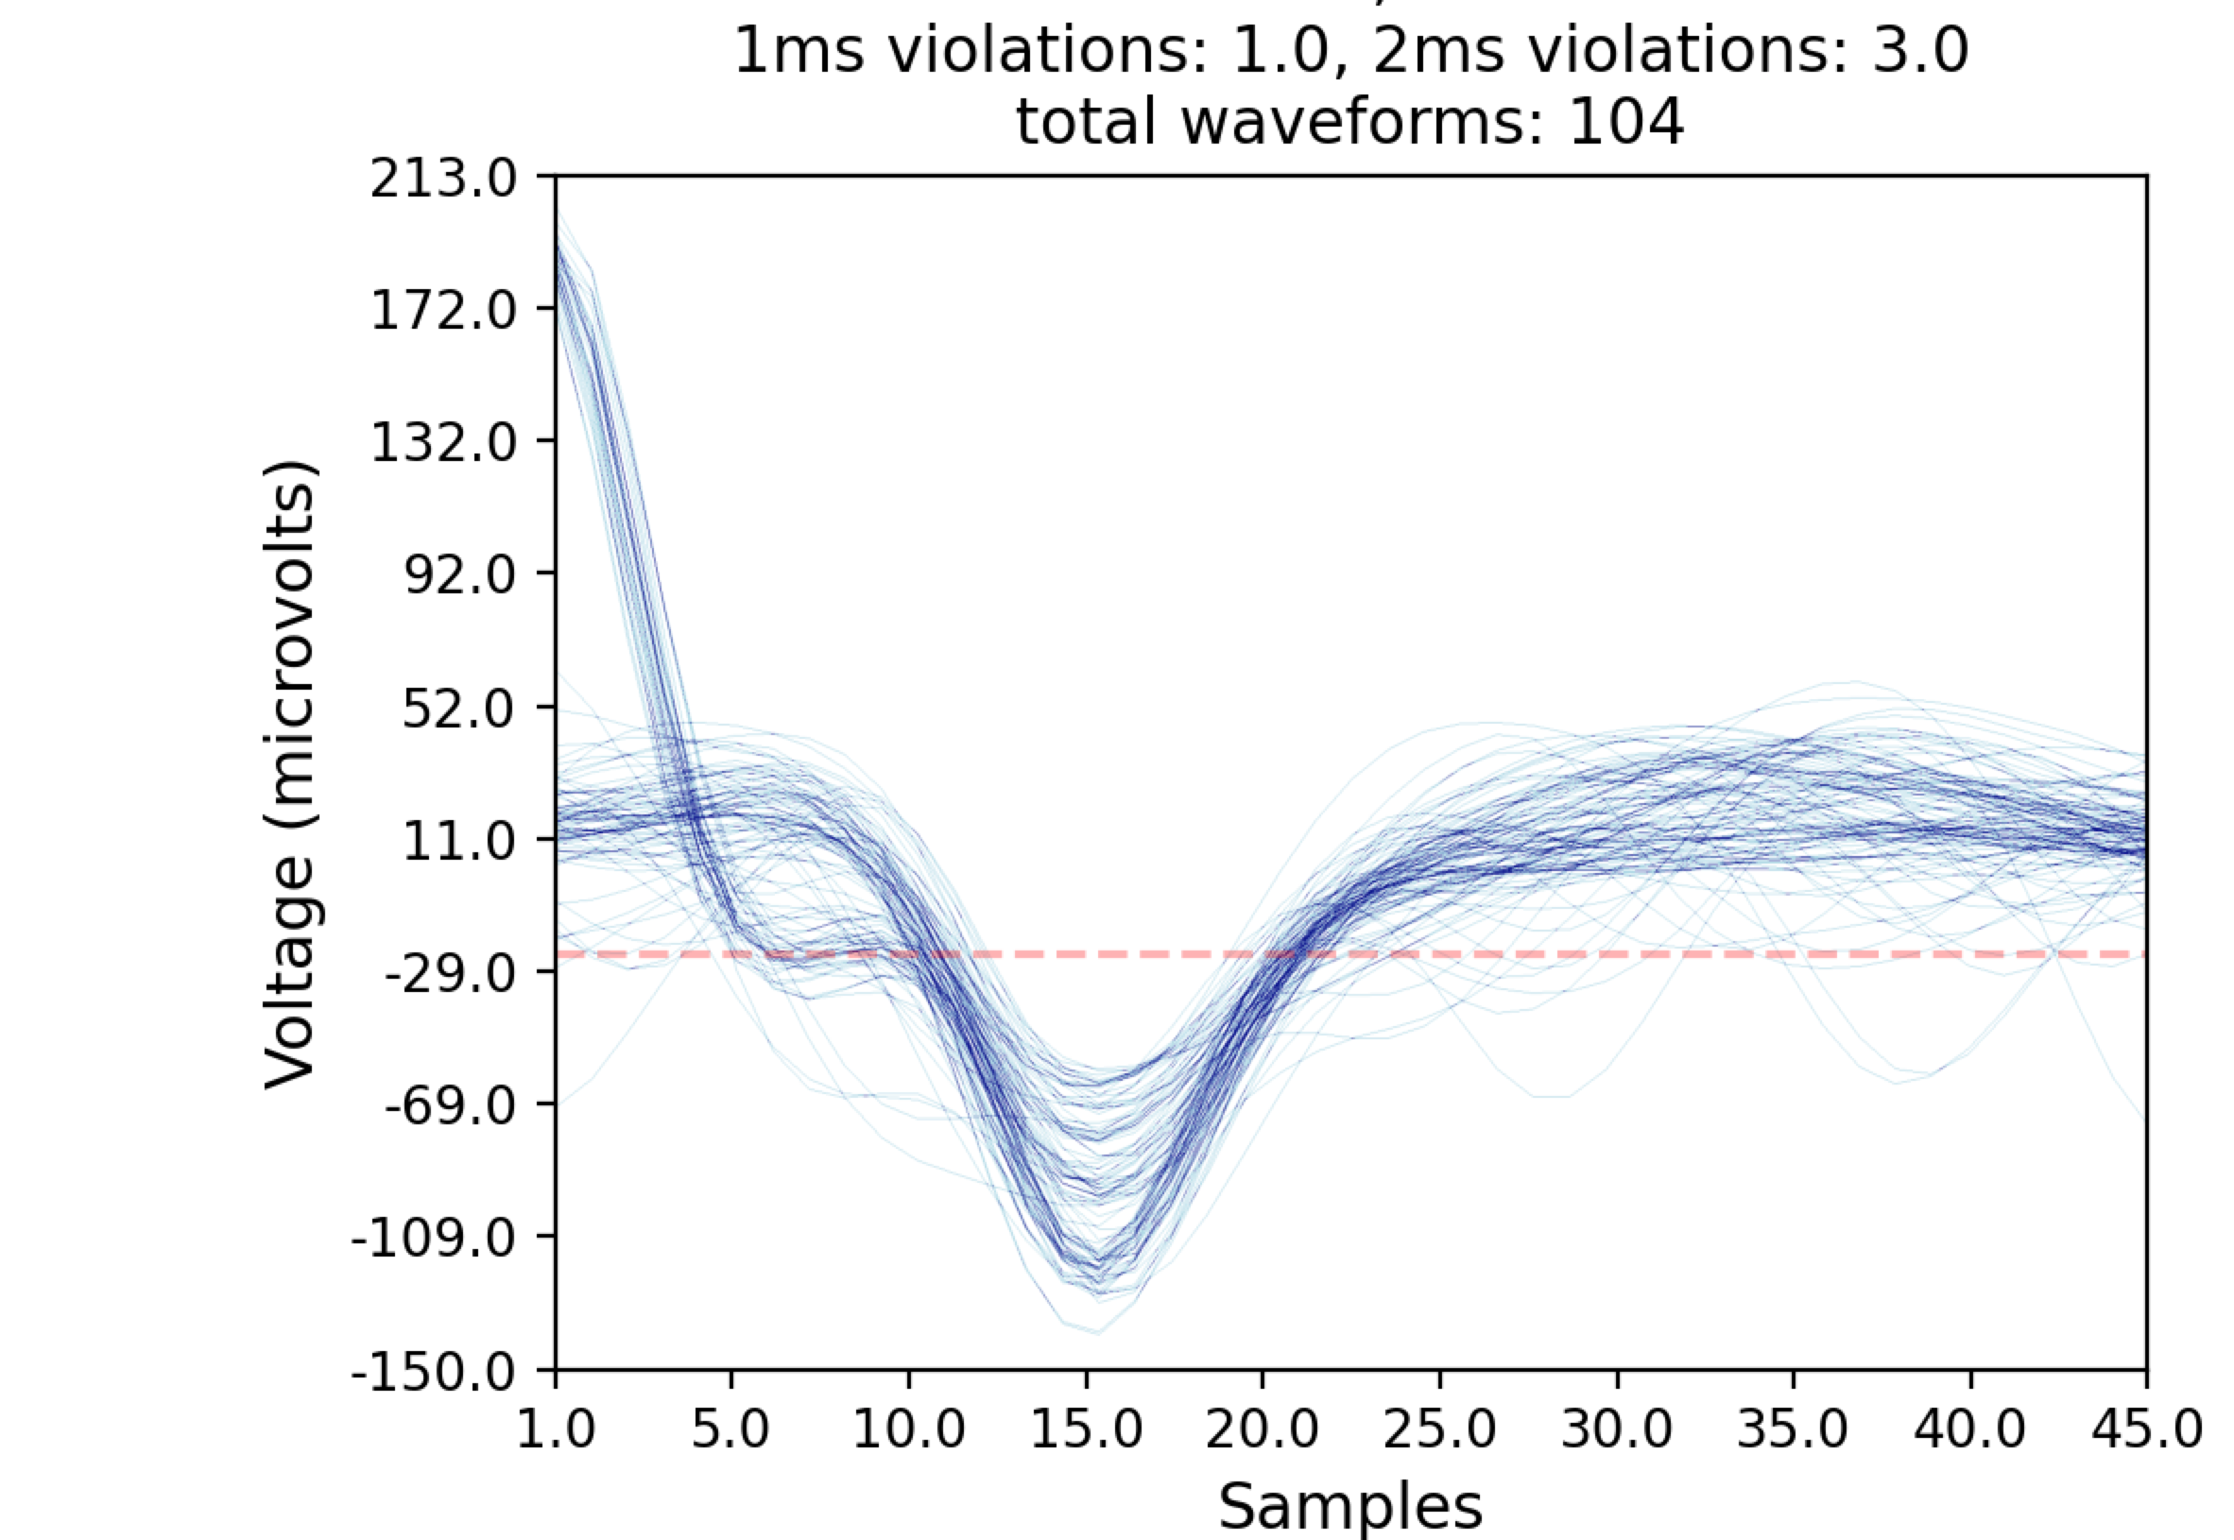
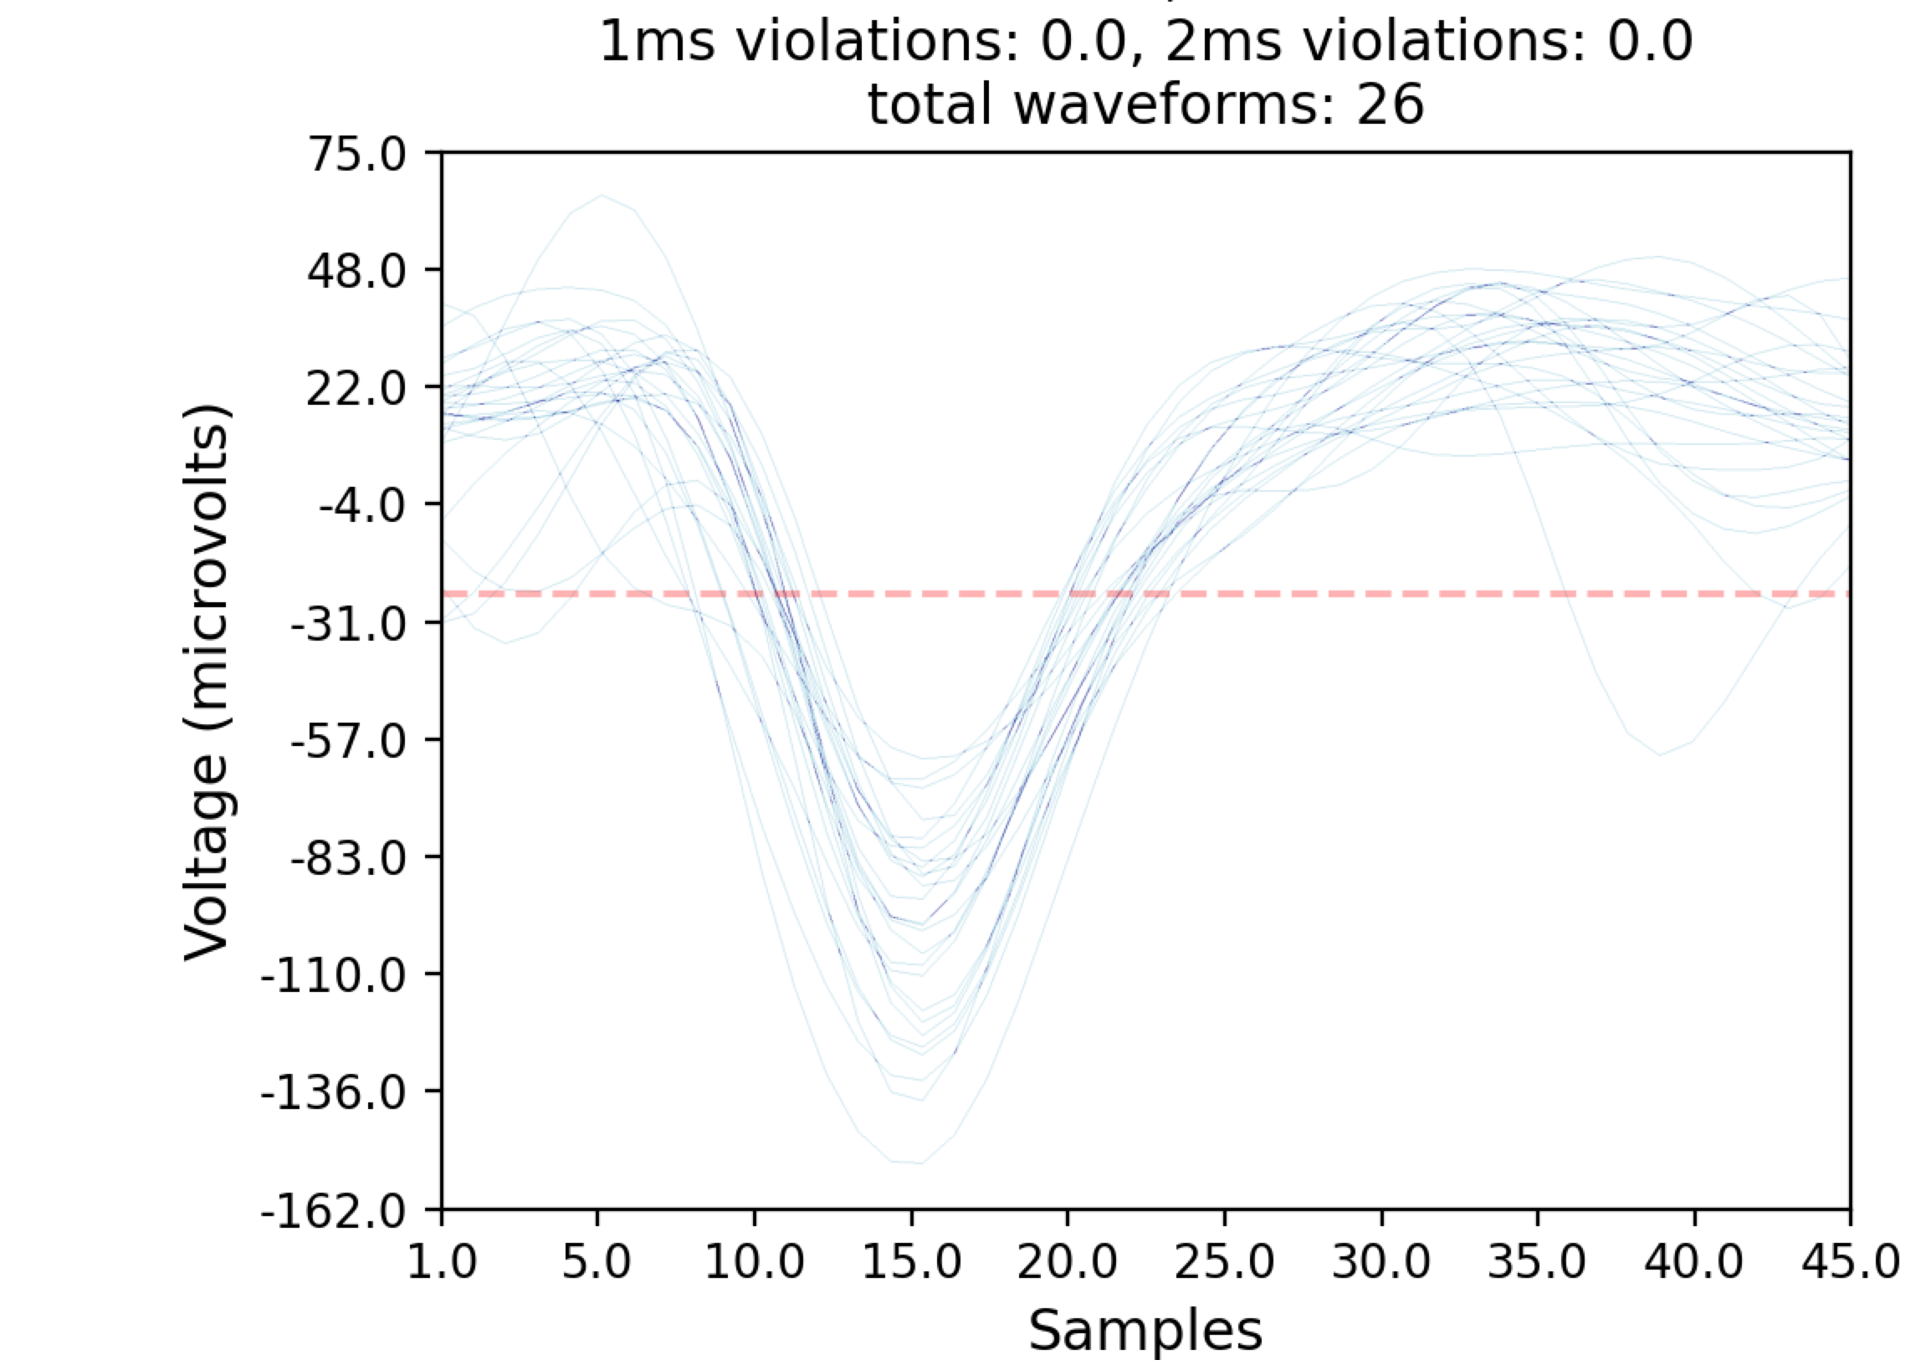
View Waves Over Time
Splits a cluster up into recording time intervals so you can look at drift and how a cluster changes over the recording.
Only a view. Does not actually split the cluster.

Slide 7
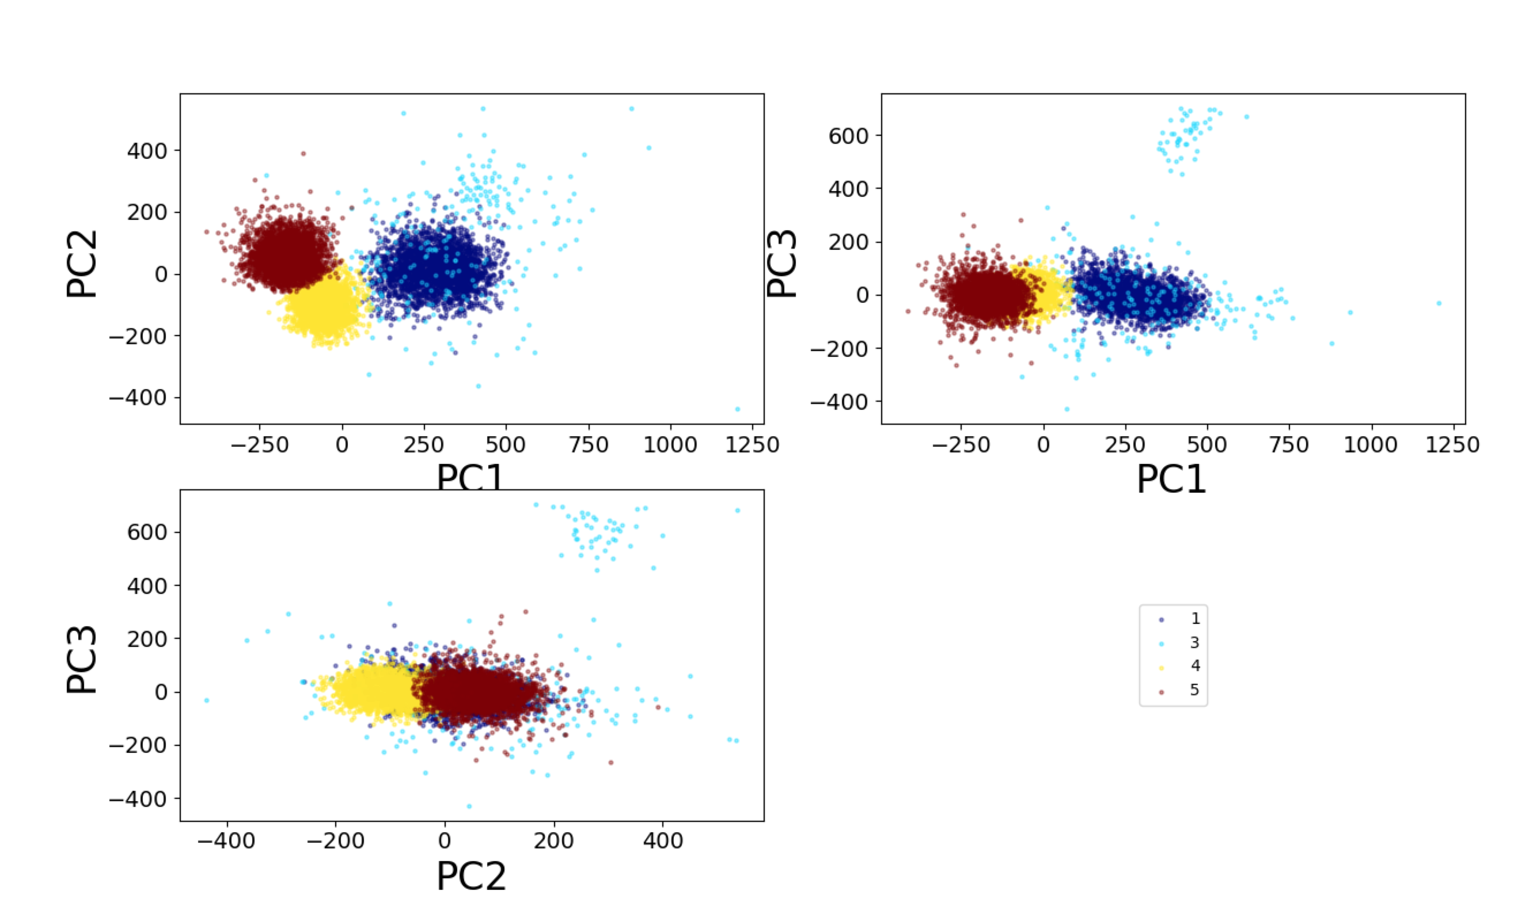
View PCA
Remember with different clusters selected then the PCA will compute different axes.
So in this example, I may see a bigger difference between 1, 4, & 5 if I dropped cluster 3

Slide 8
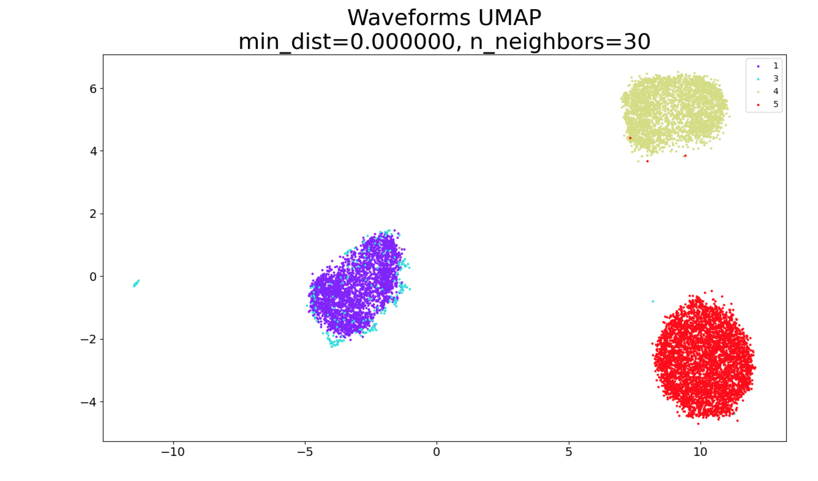
View UMAP
UMAP takes longer, but does a MUCH better job of separating clusters
However, I’m only looking at 4/6 clusters here, before saving a cluster, make sure it’s well separated from ALL clusters

Slide 9
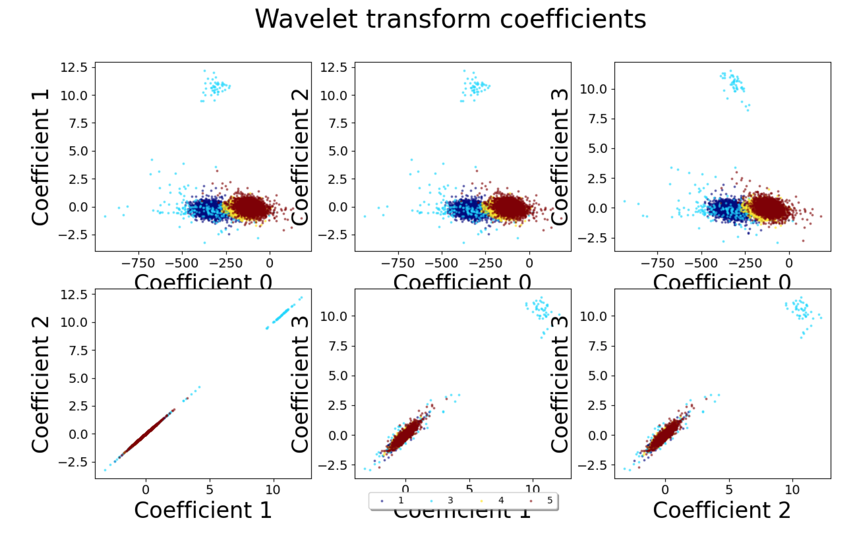
View Wavelets
Shows most separable coefficients of the wavelet transform.
This is very rarely better than PCA or UMAP.

Slide 10
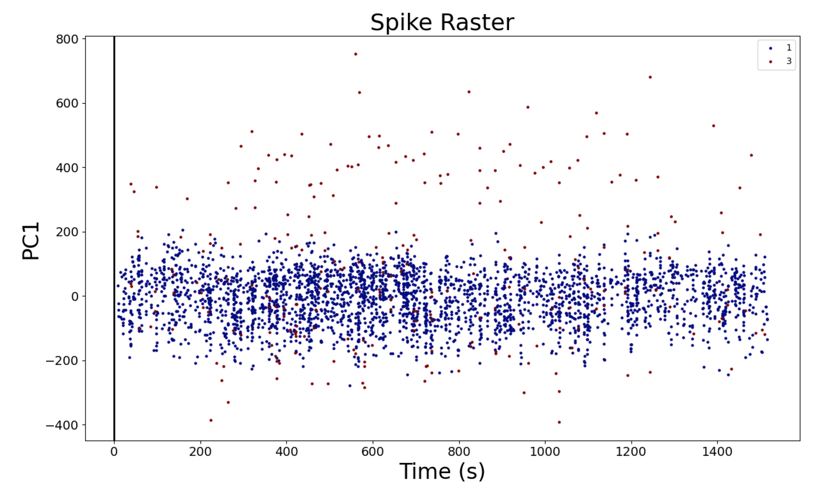
View Raster: Super useful, should always use before saving
This displays a raster using the 1st PC, very useful at seeing if there is drift within a cluster, or if one clusters spikes are tied to another cluster’s, such as with bursting neurons.

Slide 11
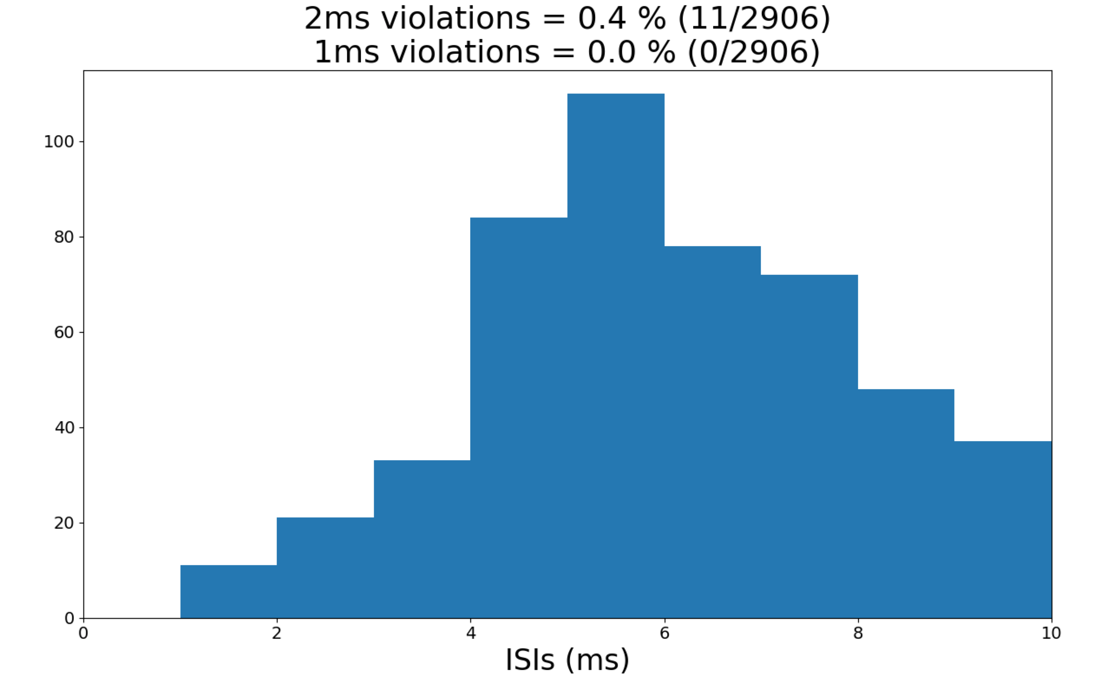
View ISI: Also a MUST use before saving

Slide 12
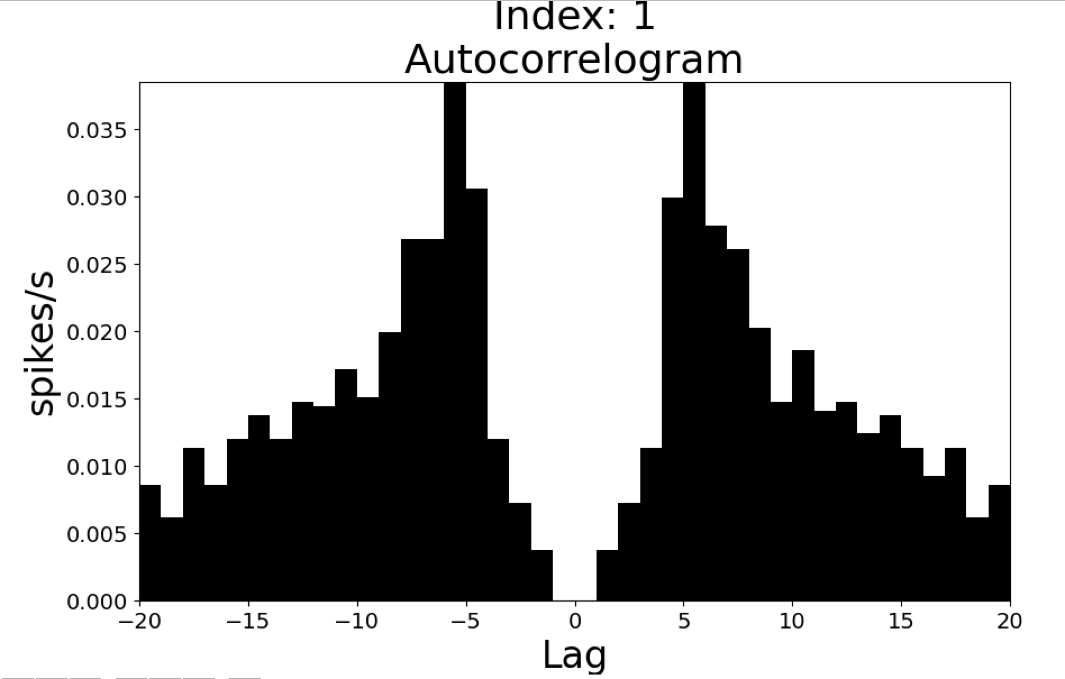
View Autocorr: similar to ISI

Slide 13
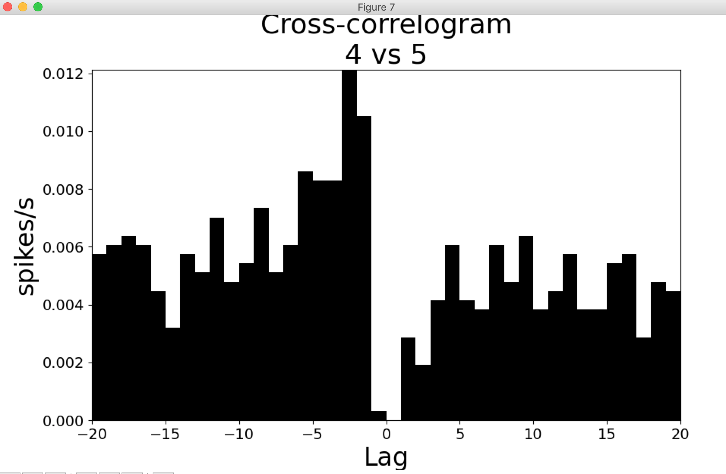
View Xcorr: Cross-correlogram
Shows relationship between spiking of clusters.
Here Cluster 5 spikes often precede cluster 4 spikes by 2-3 ms.

Slide 14
Discard Clusters
Throws out selected Clusters
Pretty self explanatory
Can get them back by either:
Re-selecting the solution number
Undo button (only reverses 1 action)

Slide 15
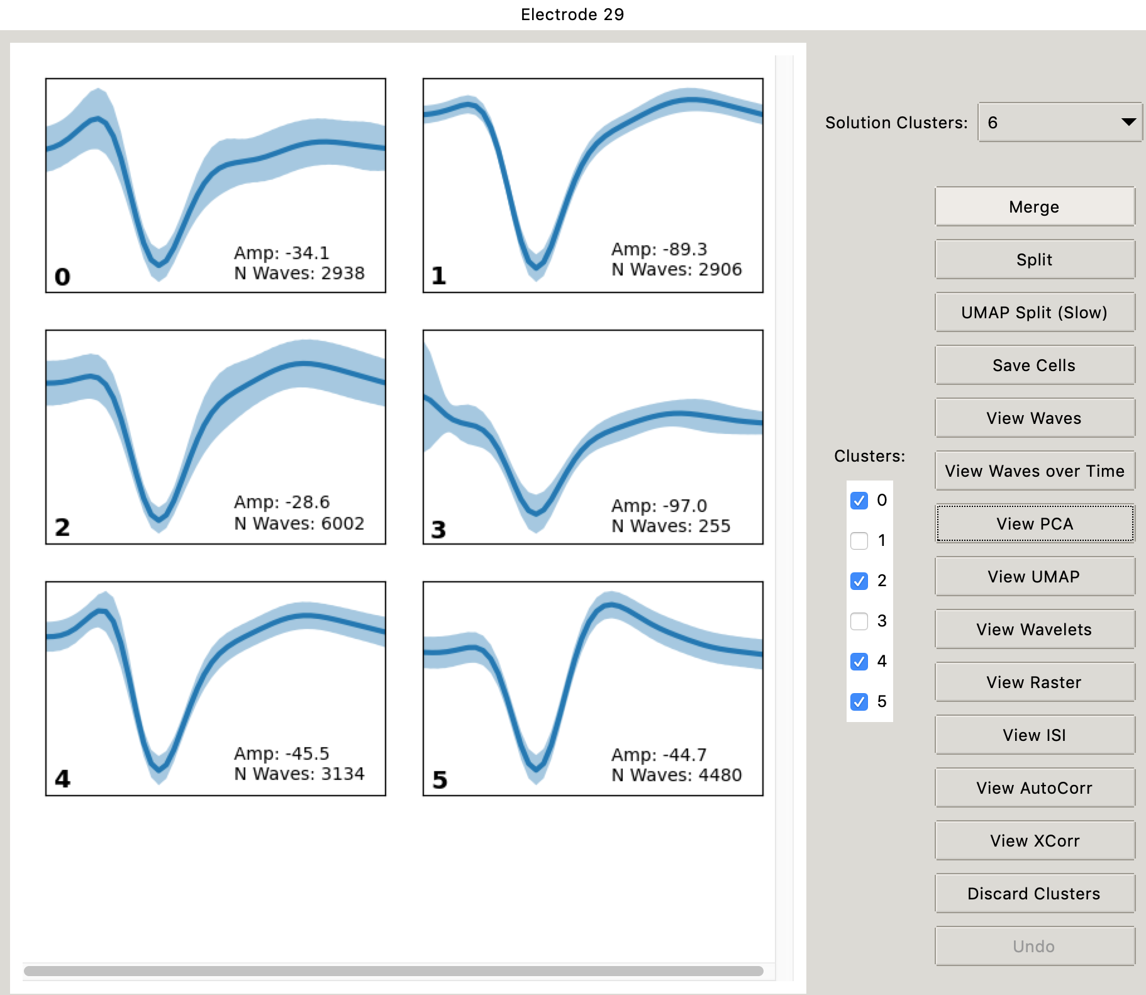
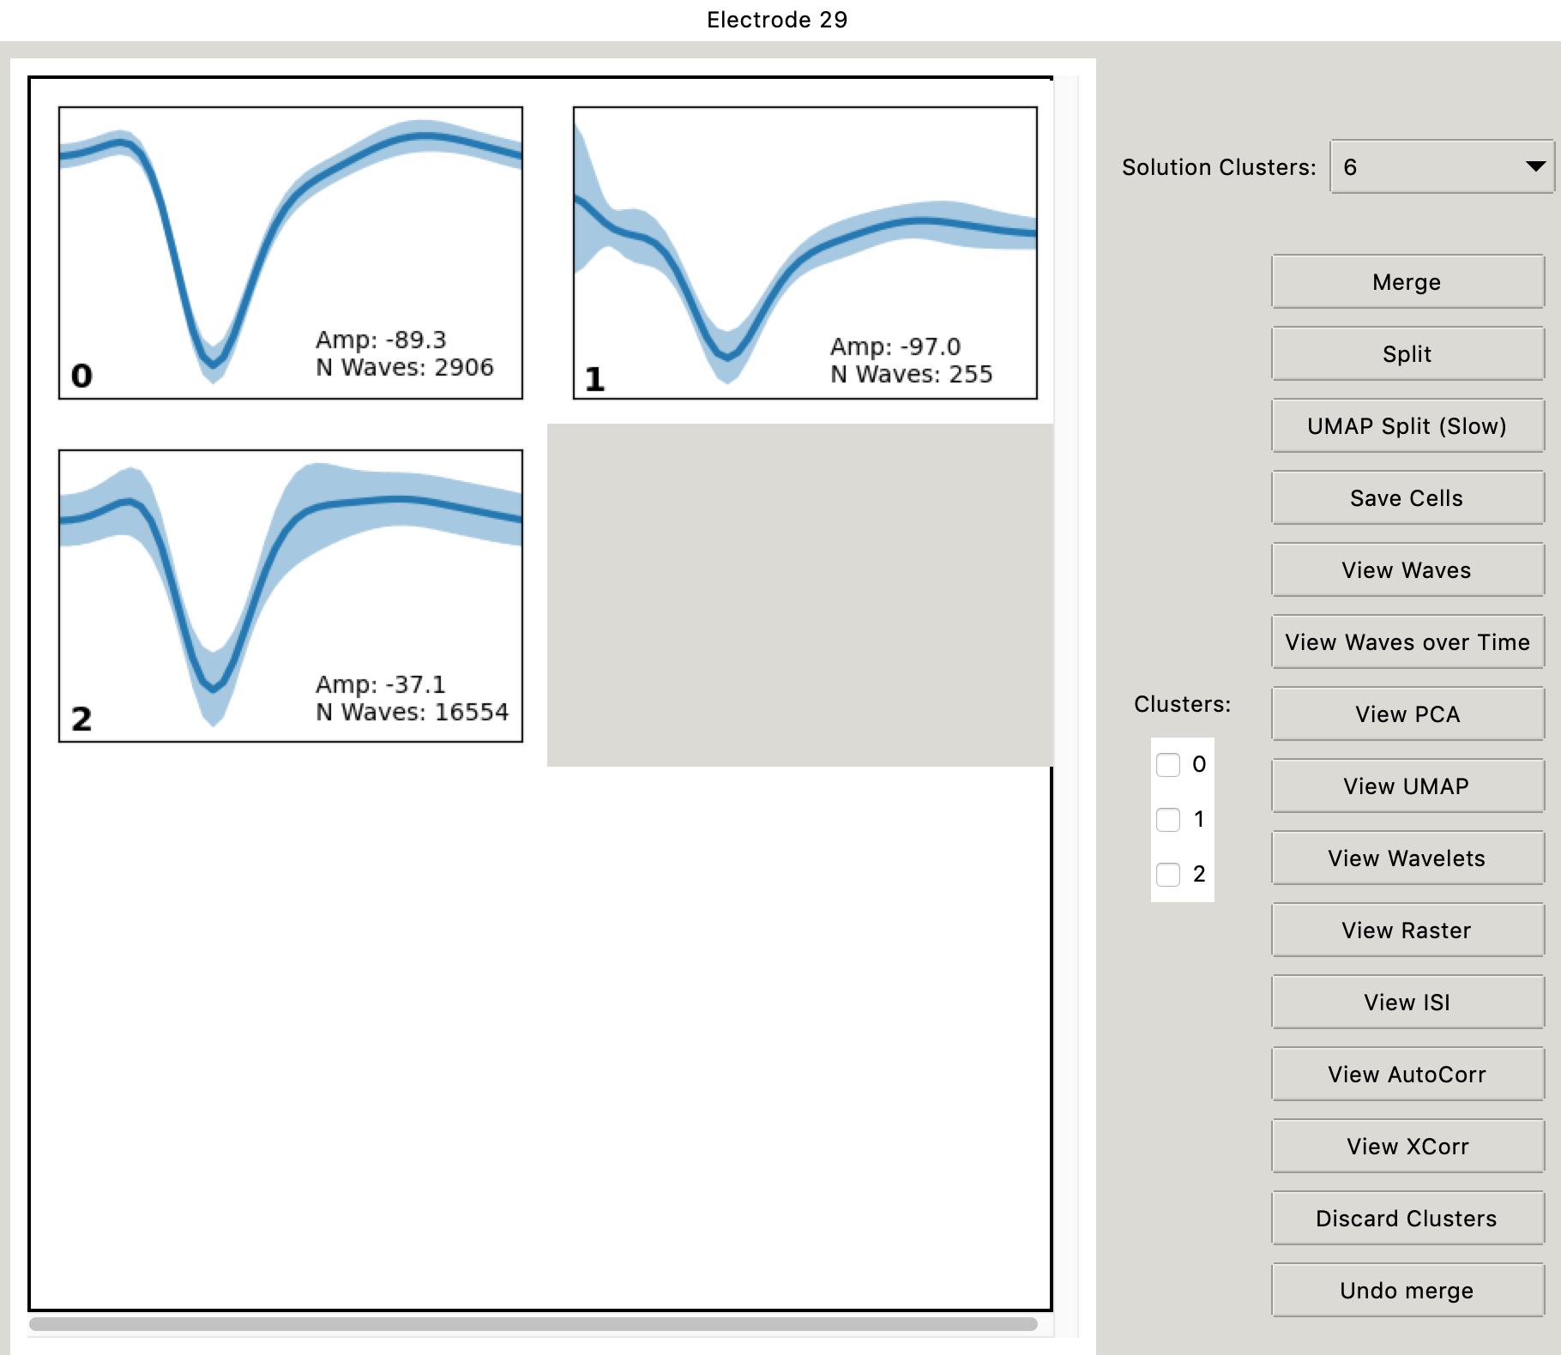
Merging
The new cluster goes at the end

Slide 16
Undo
The Undo button can only reverse a single manipulation: Merge, Split, Save or Discard

Slide 17
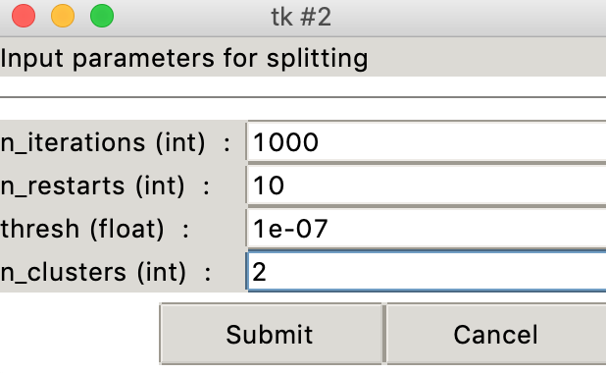
Splitting A Cluster
Split will split a single cluster using PCA and then fitting a GMM
UMAP split uses the UMAP algorithm instead of PCA. This is much slower than PCA, especially as number of spikes increase.
Both will query user for GMM fitting parameters

Slide 18
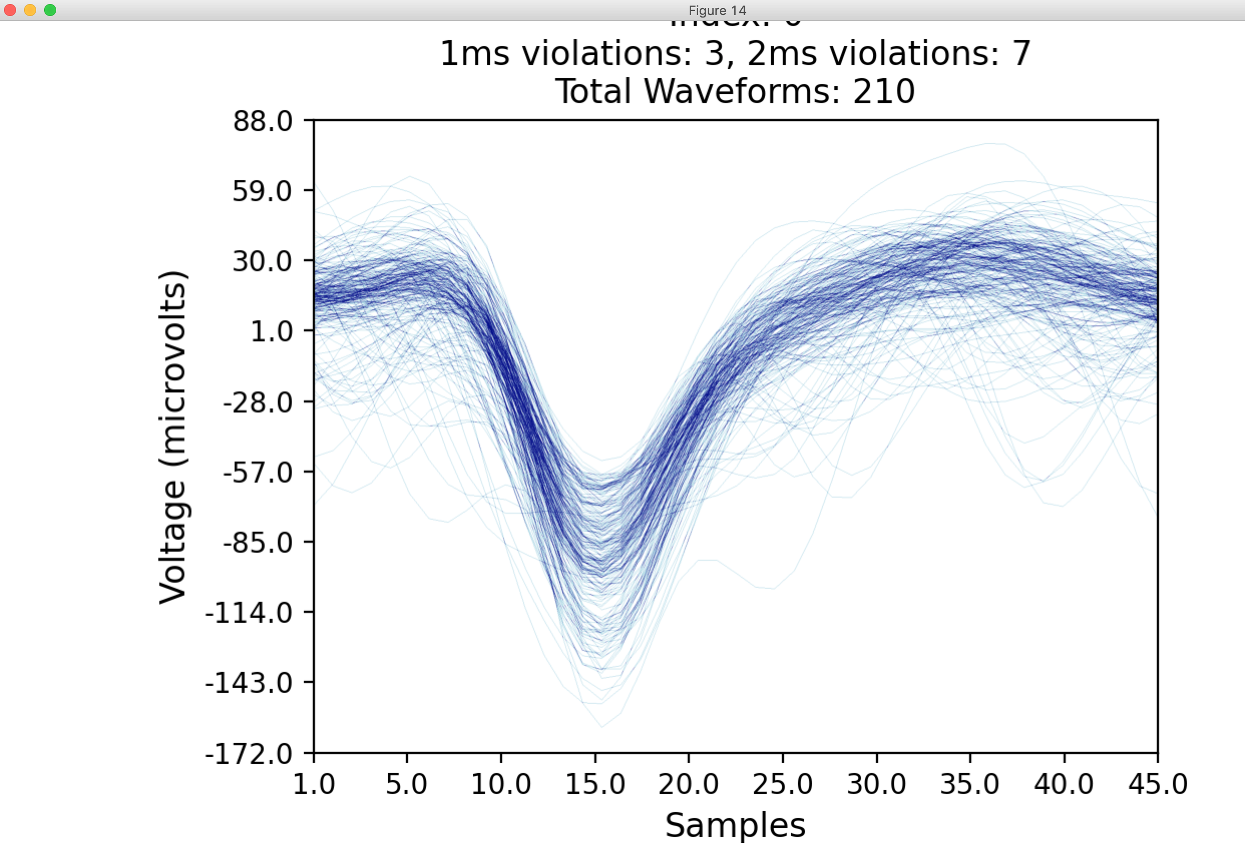
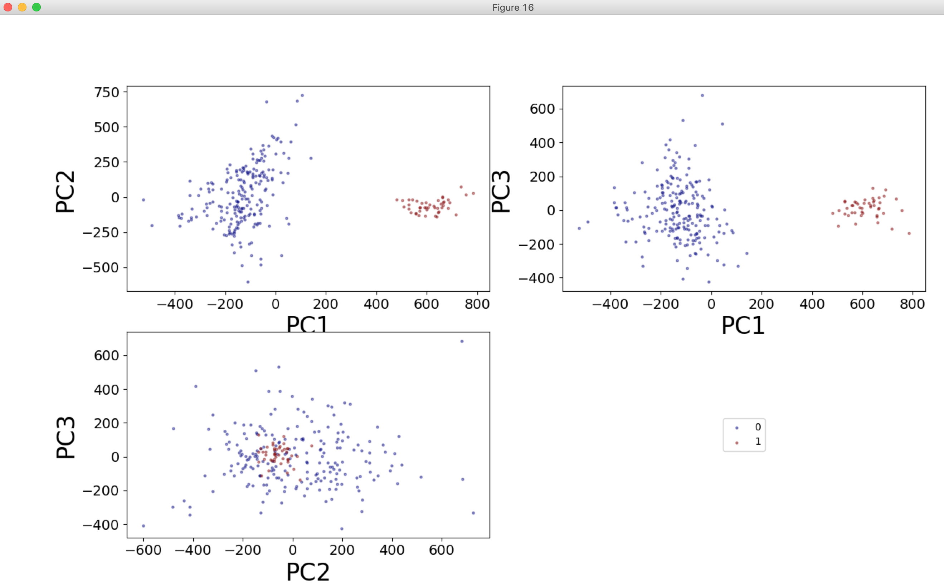
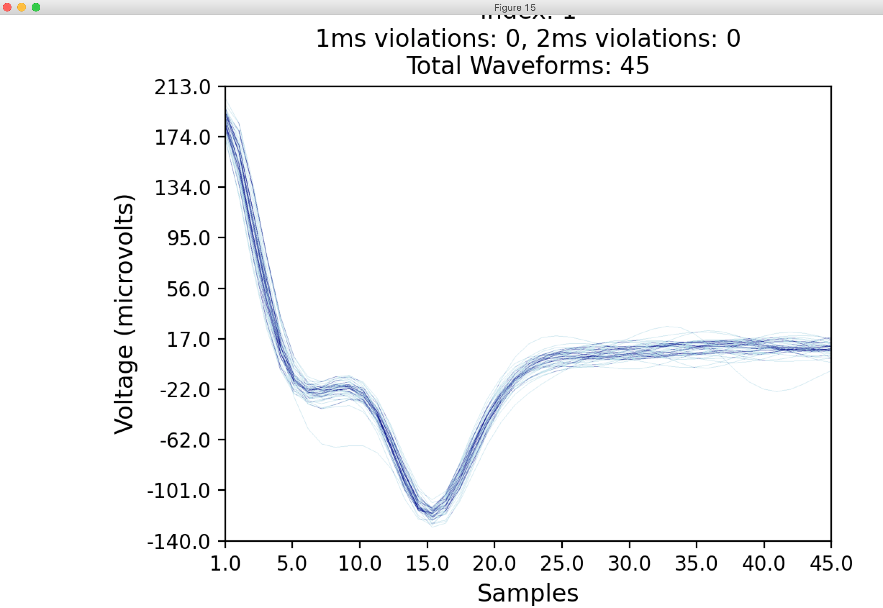
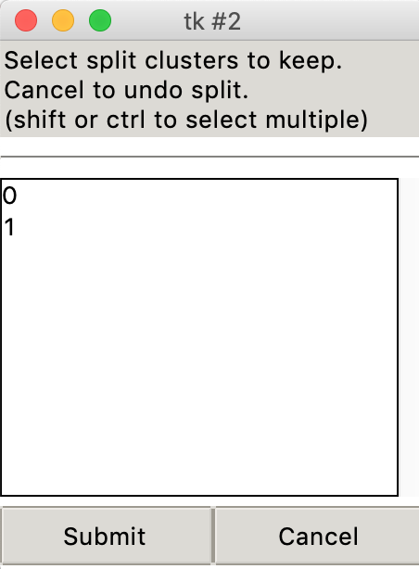
Splitting A Cluster

Slide 19
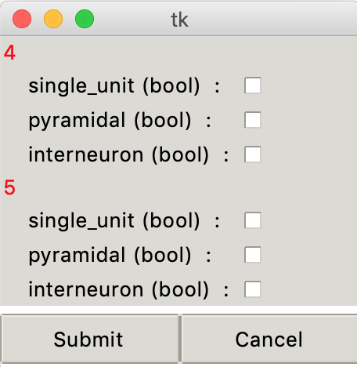
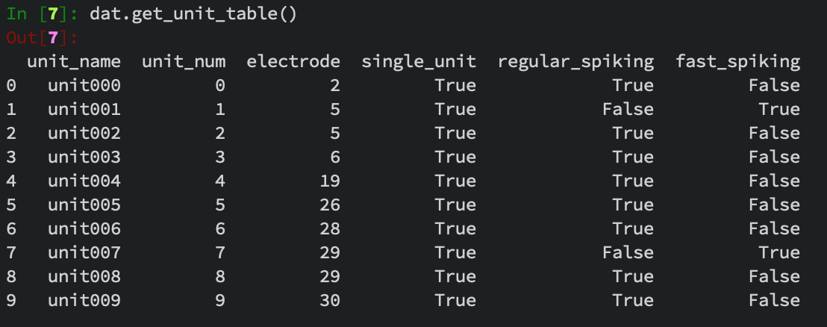
Saving Cells
Selected Clusters will be saved and removed from list.
You can select if they are single_unit, regular_spiking, or fast_spiking
I’ll be changing pyramidal and interneuron at a future date, because that’s inaccurate.
Can view saved cells at any time in ipython

Slide 20
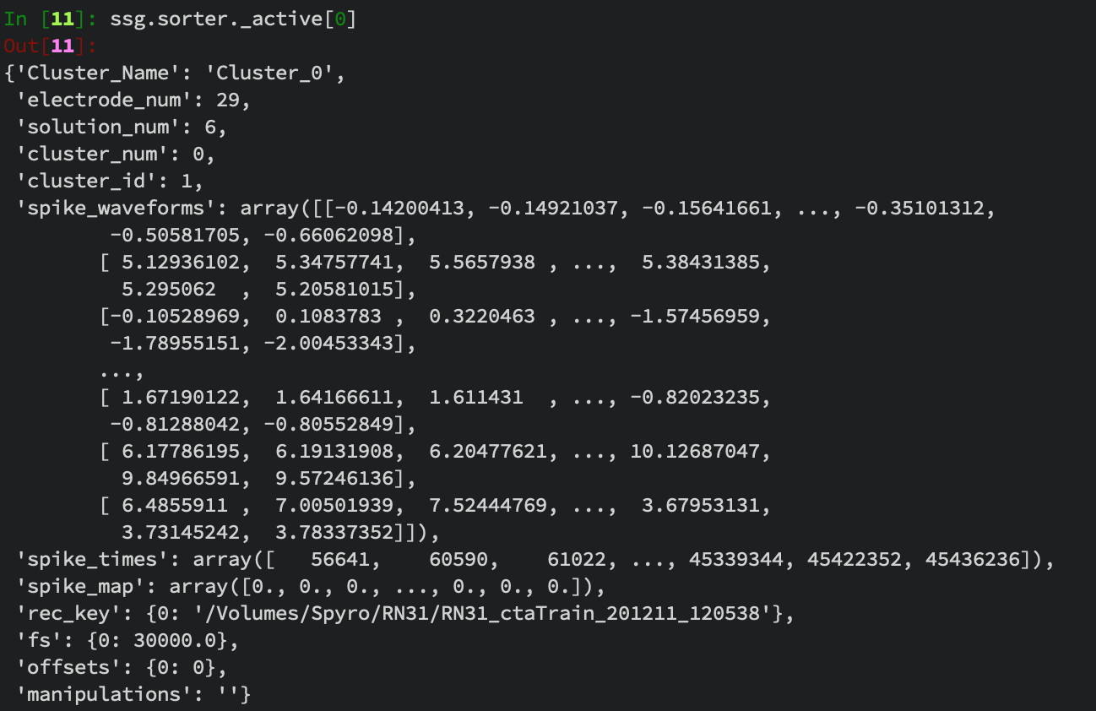
Direct Cluster Access
ssg.sorter._active
provides direct access to the spike clusters.
Developer Note:
Every row of spike_waveforms corresponds to an element in spike_times and spike_map. So removing an element from one must also remove the same elements from the other 2.
Also all manipulations should append some description of the action to the manipulations string.

Slide 21
Spike Filtering
Because of this we can apply filters directly to the clusters if we want.
For example, if we want to get rid of only these weird spikes. Or just 1 large spike, and ”Split” isn’t working well.

Slide 22
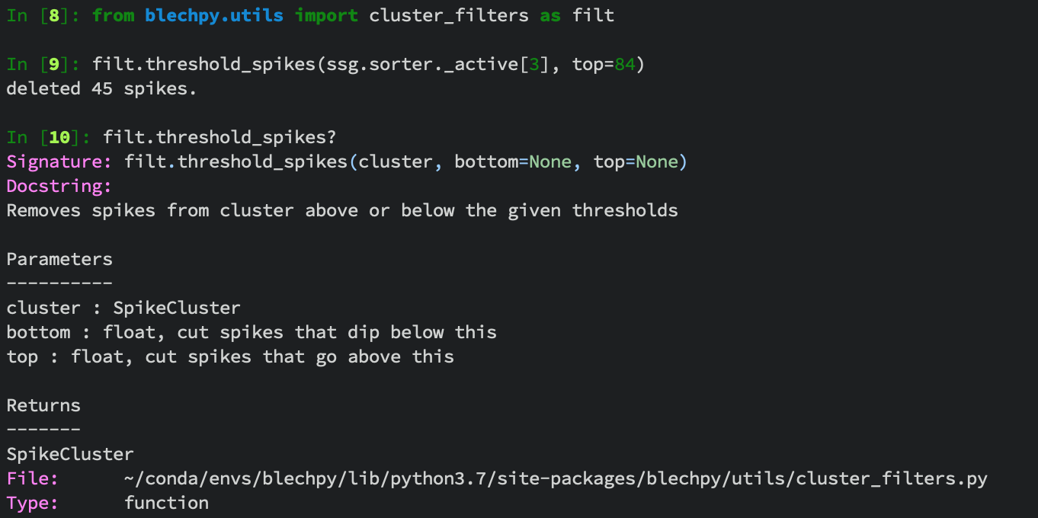
Spike Filtering
You may need to also run ssg.update() in order to refresh the quickview
Important: Doing this has no ”Undo”, if you mess up, you will have to restart sorting of this electrode

Slide 23
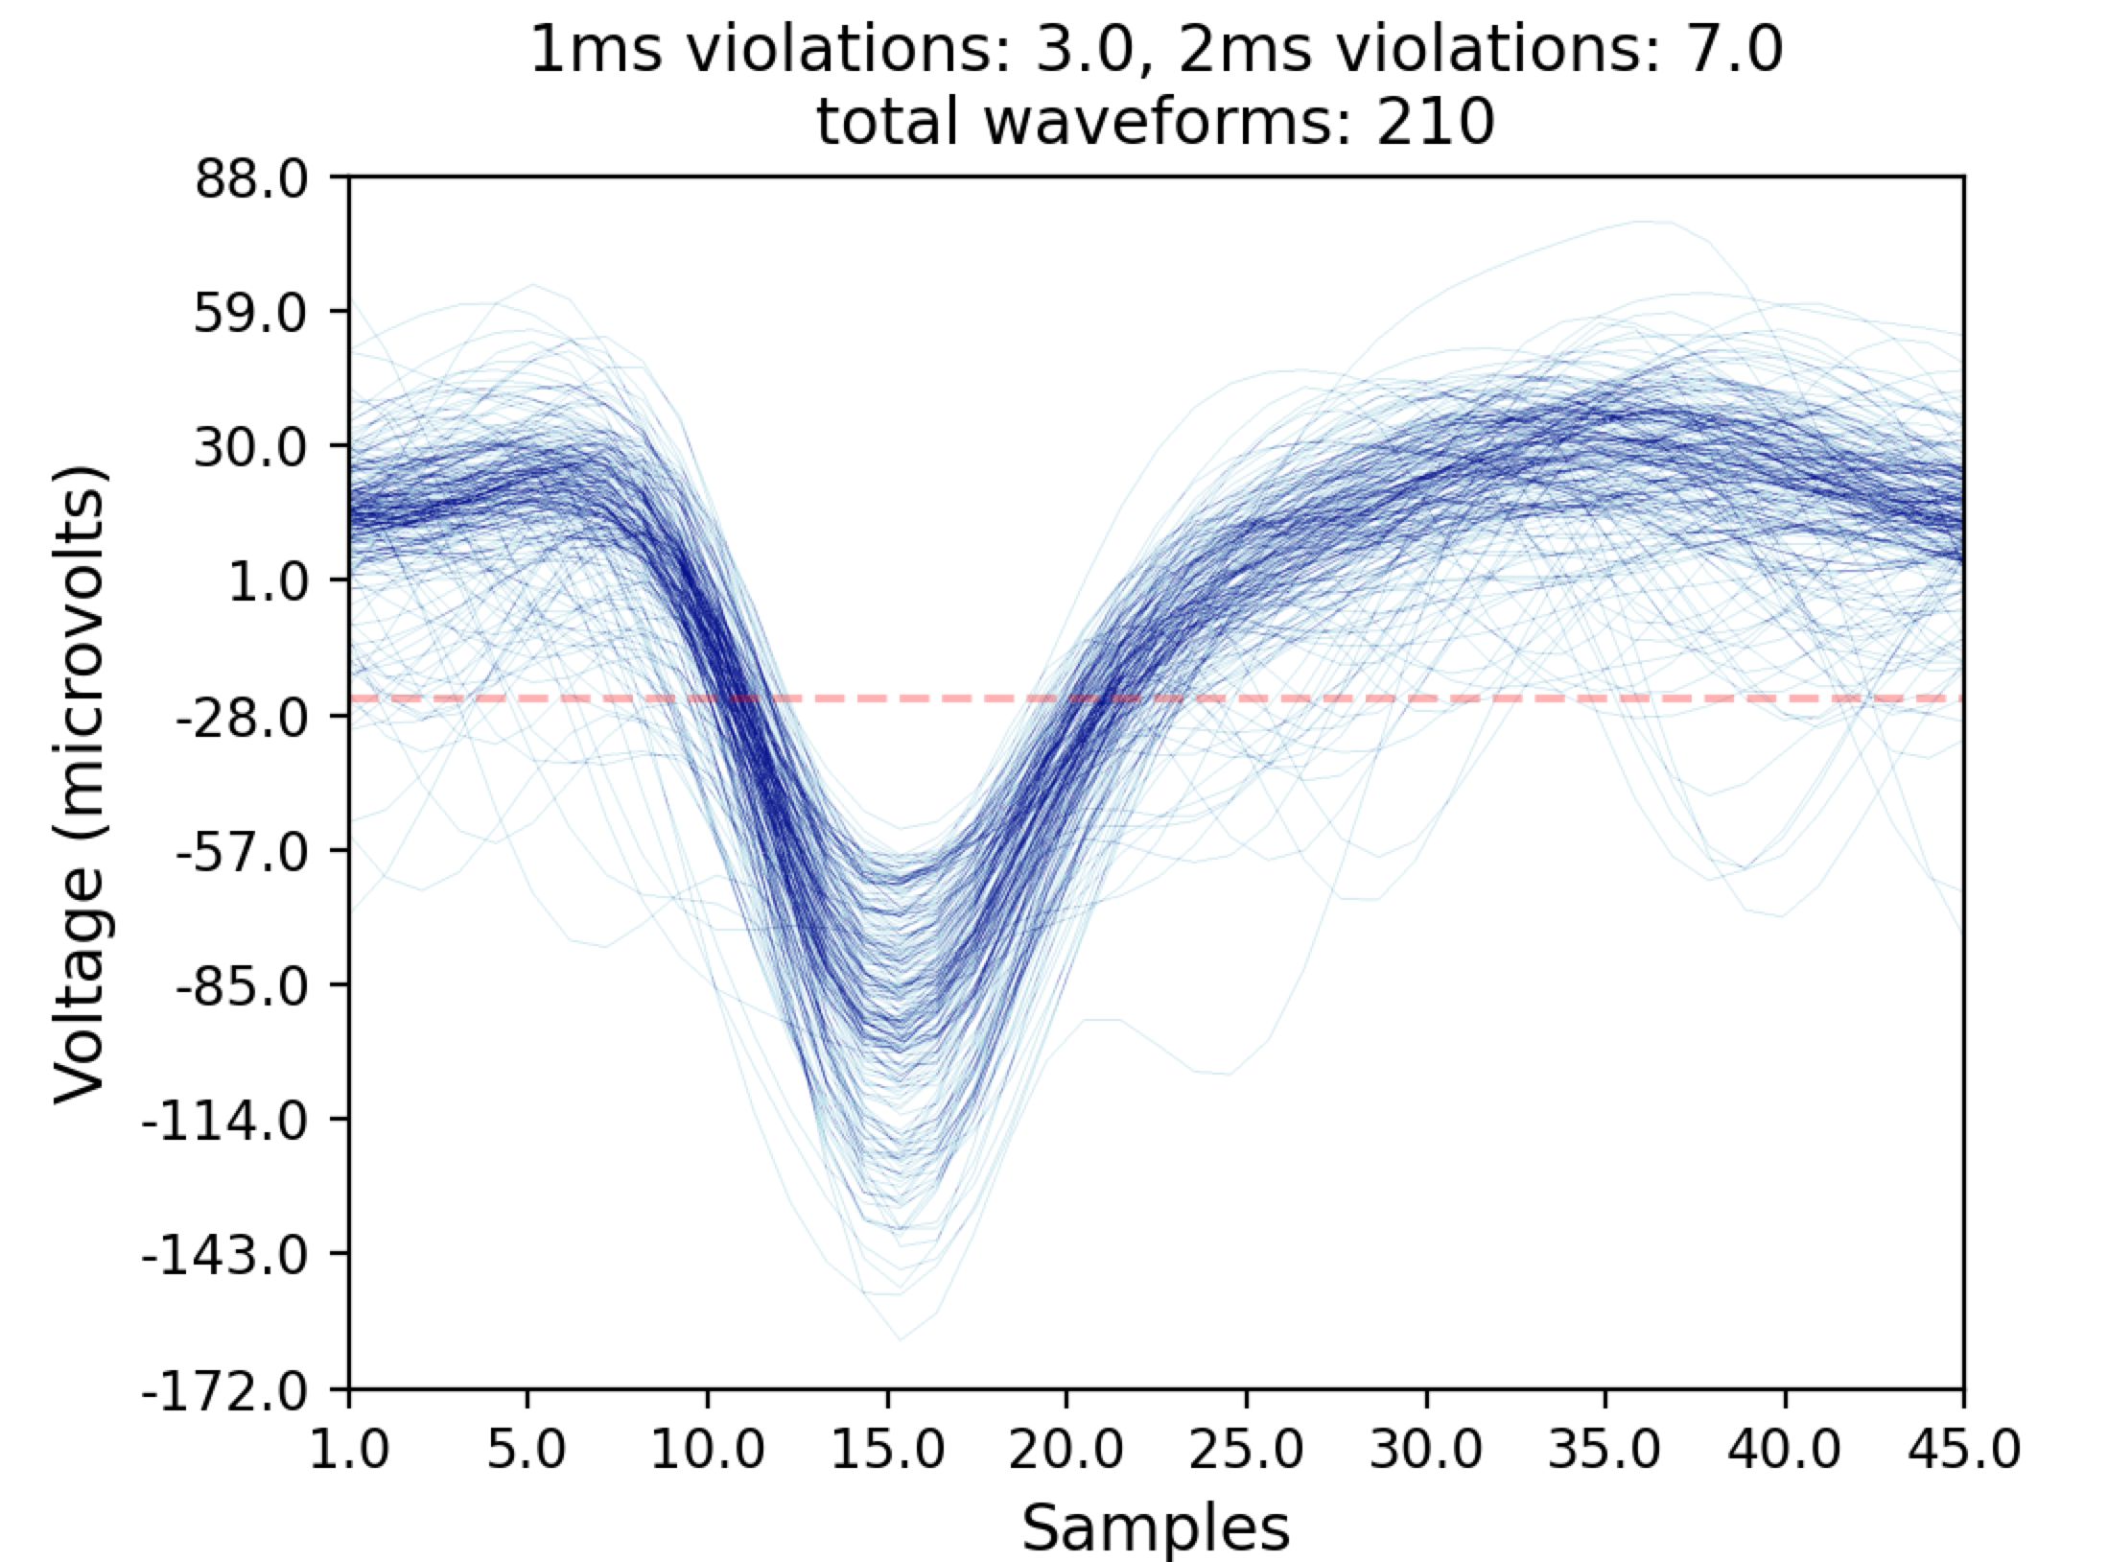
Spike Filtering
Now those 45 spikes with amplitude over 84 are gone
You can create your own cluster filters by adding them to the blechpy/utils/cluster_filters.py file

